Slide 1

DIPARTIMENTO DI INGEGNERIA INDUSTRIALE
Master Science Degree on Autonomous Vehicle Engineering
I year I Semester
CONTROL SYSTEMS FOR AUTONOMOUS GROUND VEHICLES
Challenge 2022/2023
Prof. Stefania Santini

Slide 2



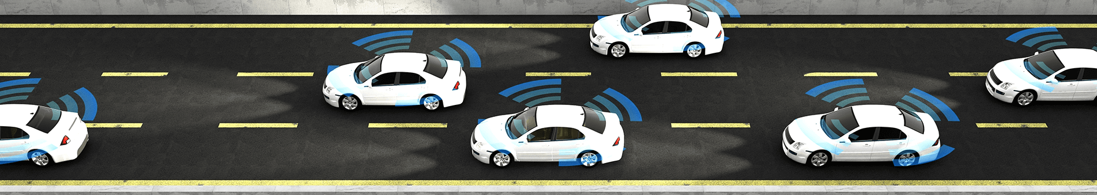
Autonomous Vehicles Control under Variable Speed Limit (VLS) system
Considering a connected autonomous vehicle (CAV), traveling in an highway scenario and able to share their state information with the surrounding environment via V2X communication. More specifically, the CAV receives information:
about position and speed of the preceding vehicles via V2V communication and on-board sensors;
about the reference speed to track, along with speed limits, from the RSU via V2I communication;

Slide 3
Problem Statement: Design of Autonomous Vehicles Control under Variable Speed Limit (VLS) system
The challenge aim is to design an ADAS system for a CAV such that the following requirements are satisfied:
The CAV tracks the reference behaviour imposed by RSU;
The CAV speed does not exceed the speed limits imposed by the RSU;
The CAV maintain a desired distance w.r.t. the preceding vehicle.

Slide 4
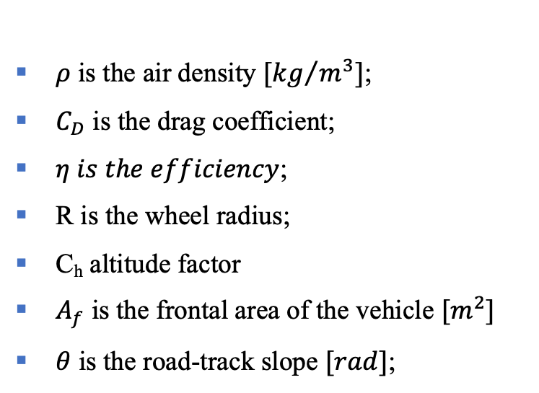
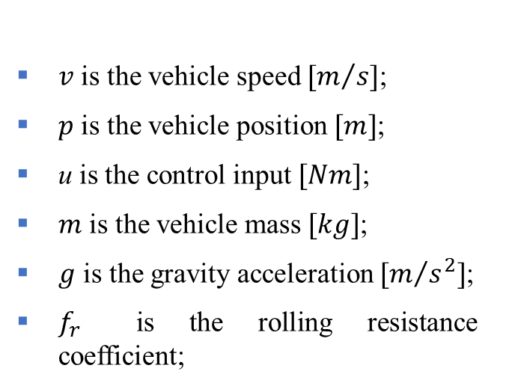
Mathematical models: Vehicle Dynamics to be considered
The vehicle dynamics to considered is described by the following nonlinear longitudinal dynamical system
$ρ$ is the air density $[{kg}/{m^{3}]}$;
$C_{D}$ is the drag coefficient;
$η is the efficiency$;
R is the wheel radius;
C_{h} altitude factor
$A_{f}$ is the frontal area of the vehicle $[m^{2}]$
$θ$ is the road-track slope $[rad]$;
$v$ is the vehicle speed $[m/{s]}$;
$p$ is the vehicle position $[m]$;
u is the control input $[Nm]$;
$m$ is the vehicle mass $[kg]$;
$g$ is the gravity acceleration $[m/{s^{2}]}$;
$f_{r}$ is the rolling resistance coefficient;

Slide 5
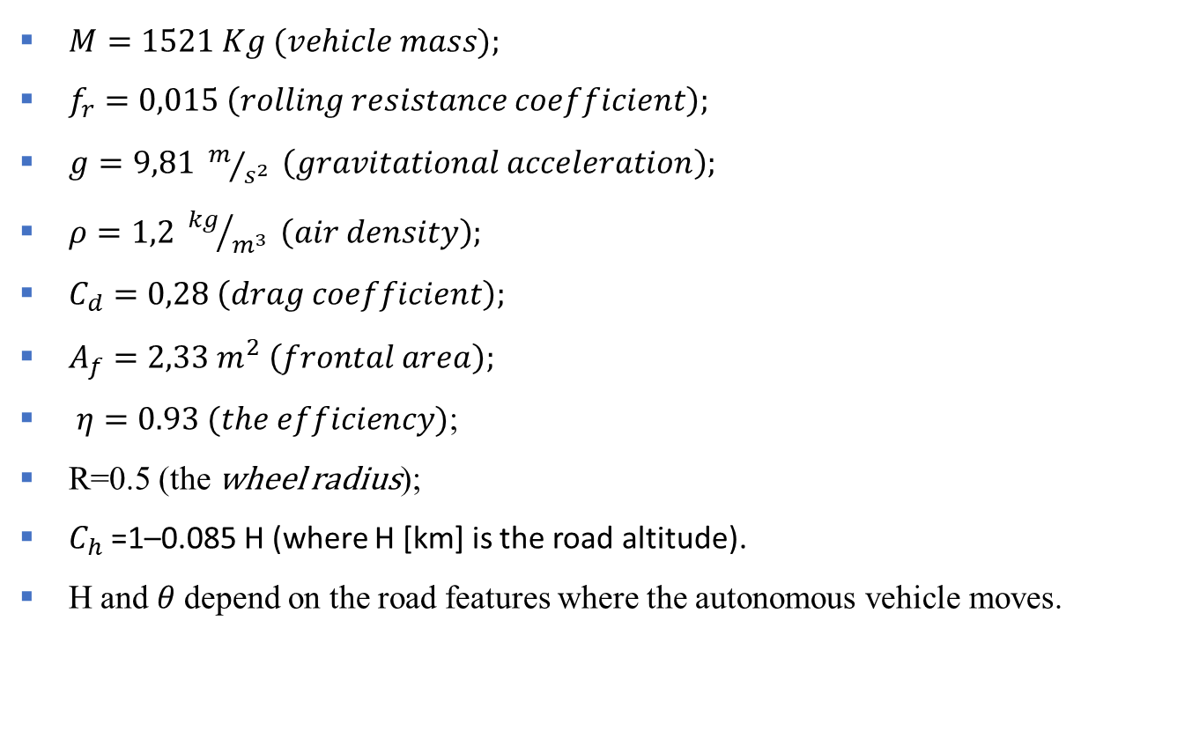
Vehicle Dynamics parameters
$M=1521 Kg (vehicle mass);$
$f_{r}=0,015 \left(rolling resistance coefficient\right);$
$g=9,81 m/{s^{2}} \left(gravitational acceleration\right);$
$ρ=1,2 {kg}/{m^{3}} \left(air density\right);$
$C_{d}=0,28 \left(drag coefficient\right);$
$A_{f}=2,33 m^{2} \left(frontal area\right);$
$η=0.93 (the efficiency)$;
R=0.5 (the wheel radius);
$C_{h}$=1–0.085 H (where H [km] is the road altitude).
H and $θ$depend on the road features where the autonomous vehicle moves.

Slide 6
Challenge Road Map
The challenge is articulated into the following steps:
Implement a Matlab/Simulink Scheme allowing emulating the behavior of the CAV.
Implement a block able to emulate the RSU such that it imposes a constant reference speed to be tracked and constant speed limits.
Design the ADAS for the autonomous vehicle and validate it.
Create a realistic road highway section in which the vehicle can move and emulate the presence of other vehicles present on the selected road section by exploiting the Automated Driving toolbox.
Validate the ADAS in the road section you create.
Make an extensive simulation analysis for validating the proposed controller. For the extensive simulation, create a driving scenario where there are different highway road section and the RSU imposes a variable speed reference behavior.
Test the robustness of the proposed approach by considering uncertainties of 10% on the vehicles parameters.

